Slide 1
Compassion

Slide 2
Elsie: We light this candle in the name of God the Father, God the Son and God the Holy Spirit.

Slide 3
Sennen: Can you think of a time that you have shown compassion this week?

Slide 4
Gracie: Can you think of a bible story which shows compassion?

Slide 5
a
Engage…
Let’s look at what’s in the Bible or the world…

Slide 6
Watch: https://www.youtube.com/watch?v=SWDgdPiNpz0
Sienna: We’re going to watch a video about Jesus showing compassion to someone who needed his help.

Slide 7
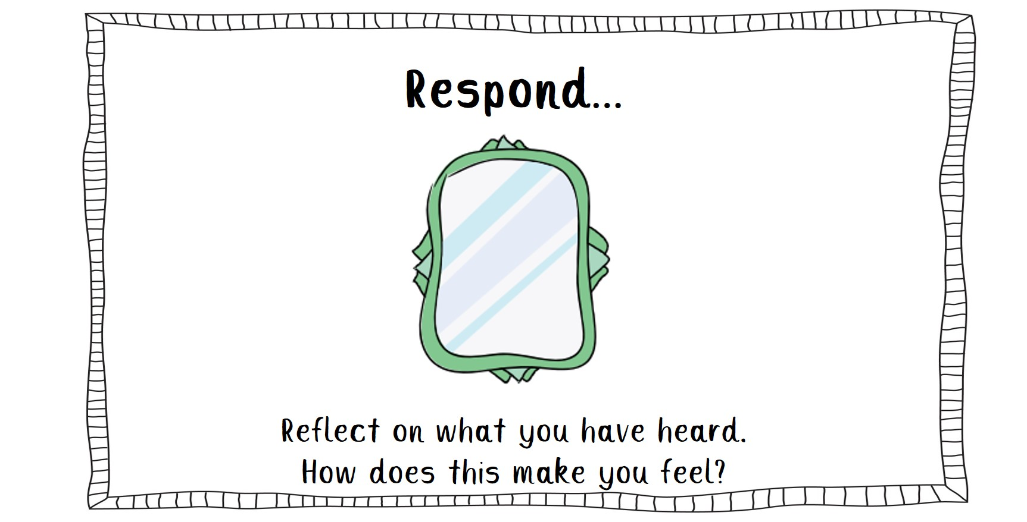

Slide 8
Ellie: Who do you think showed compassion in this bible story?

Slide 9
Bow: How do you think the religious leaders felt when they saw that Jesus had healed the paralysed man?

Slide 10
Jenson: What do we need to do to follow Jesus’s example in this bible story?

Slide 11
Alex: Let’s look at the bible:

Slide 13
Lexi –How can you make a difference to someone by sharing your gift of compassion this week?

Slide 14
An invitation to pray… Dear God, Thank you for teaching us how to be compassionate. Help us to understand how others are feeling, especially when times are tough. Amen
Elsie:

Slide 17
Sennen: God be with you

