Slide 1
Respect

Slide 2
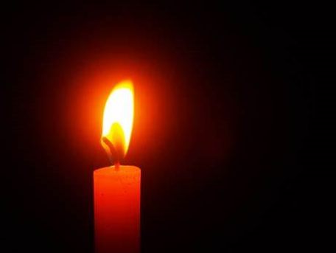
Poppy: We light this candle in the name of God the Father, God the Son and God the Holy Spirit.

Slide 3
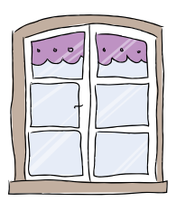
a
Engage…
Let’s look at what’s in the Bible or the world…

Slide 4
Alex: Let’s look at our story from the bible for today:
Creation (Genesis 1-2) (youtube.com)

Slide 5
.
Poppy: Based on the fact that God created the world.
How do you think that we should treat his creation?

Slide 6
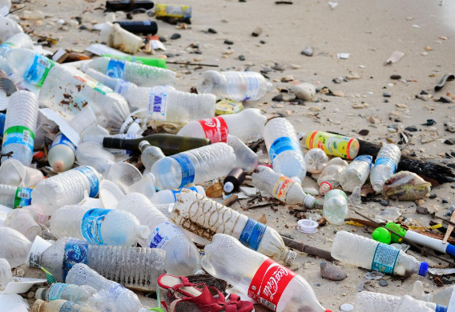
Sennen: What do you think is happening in this image?

Slide 7
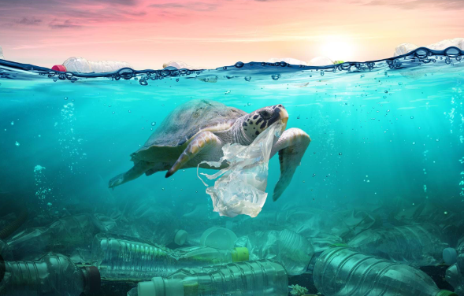
Elsie: What do you think is happening in this image?

Slide 8
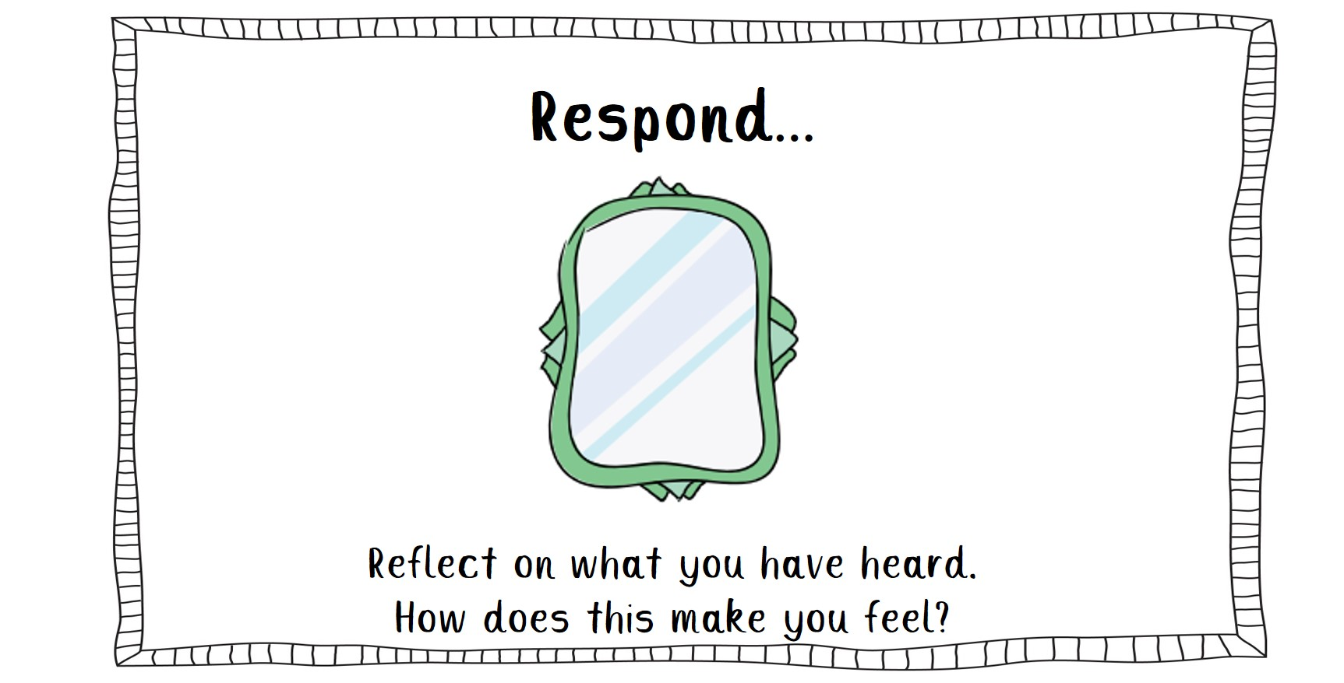

Slide 9
Sienna: How do you think God would feel about the pictures we have seen?

Slide 10
Bow – Based on the pictures that we have seen. What do you think we should do?

Slide 11
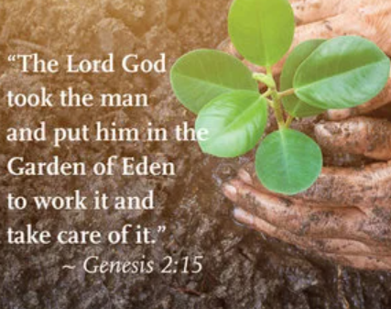
Sennen: Let’s a look at the bible -

Slide 13
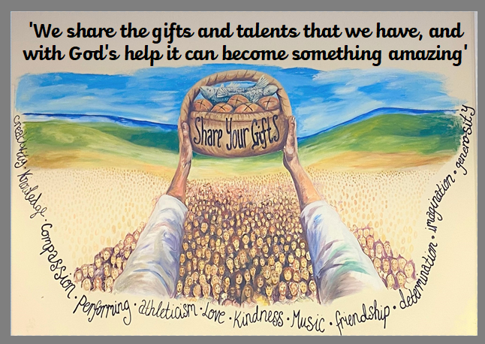
Lexi –So how can you make a difference by sharing your gifts and talent of respect this week?

Slide 14
An invitation to pray…
Alex/Ellie:

Slide 17
Jenson: God be with you

