Slide 1
Forgiveness

Slide 2
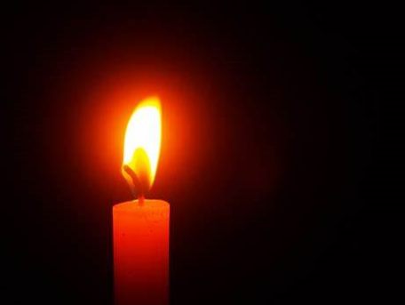
Lexi: We light this candle in the name of God the Father, God the Son and God the Holy Spirit.

Slide 3
Lexi: Which Christian value could these images represent and why?

Slide 4
Sienna: Can you think of a time that you have had to show forgiveness to someone?

Slide 5
Jenson: Can you think of a bible story which shows forgiveness?

Slide 6
a
Engage…
Let’s look at what’s in the Bible or the world…

Slide 7
Watch: The Prodigal Son (youtube.com)
Bow: We’re going to watch a video showing a parable from the bible about forgiveness.

Slide 8
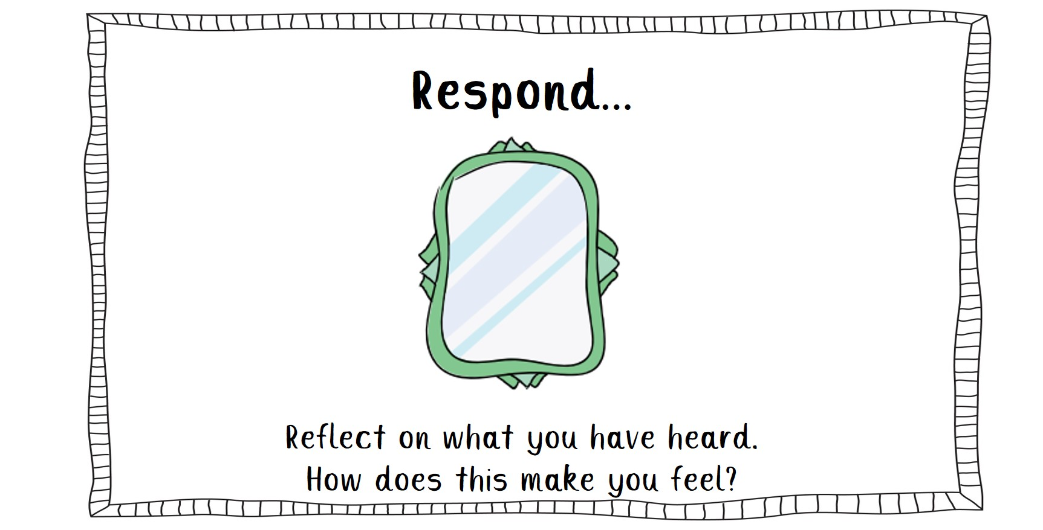

Slide 9
Ellie: Who do you think the dad represents in this story?

Slide 10
Elsie: Why do you think the older brother acted that way?

Slide 11
Poppy: Think to yourself – Have you ever acted like the older brother and not like the dad?

Slide 12
Sennen: What can we learn from this bible story?

Slide 13
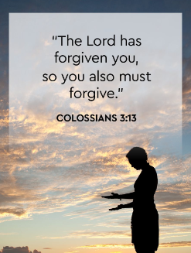
Alex: Let’s look at the bible:

Slide 15
Jenson –How can you make a difference to someone by sharing your gift of forgiveness this week?

Slide 16
An invitation to pray… Dear God, Thank you for helping us to forgive each other, just like Jesus forgave us for our sins. Help our friendships continue the way they were before. Amen
Poppy:

Slide 19
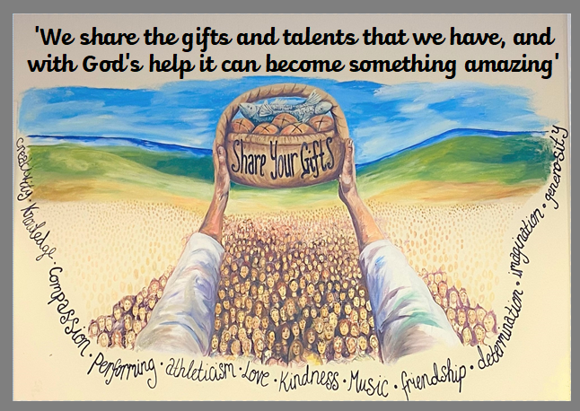
Sienna: God be with you

